Slide 1
Golf Ball Tracking and Intercepting System
Mechanical Engineering
Tennessee Tech

Slide 2
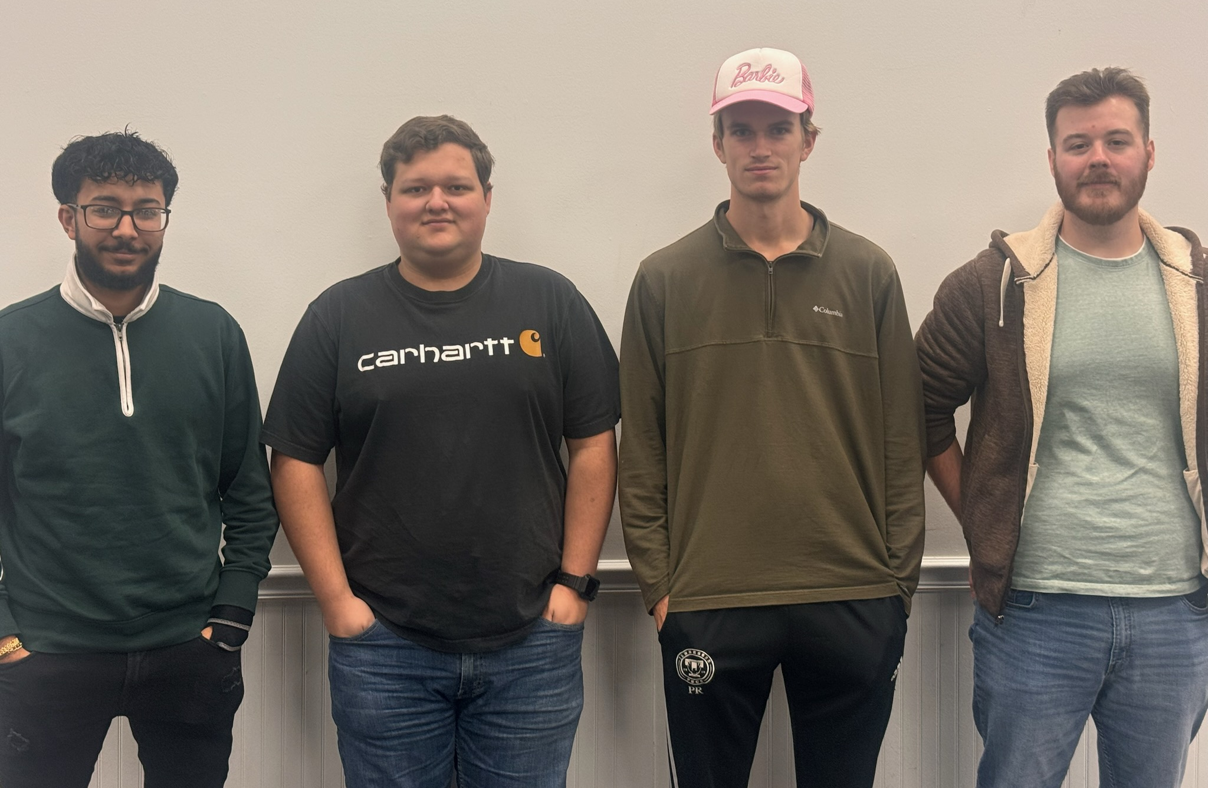

Members and Goals
This is a project being presented to High School students with DevCom sponsoring. This is not only to explain and show high school students an interesting engineering solution to an engineering problem but also to display DevCom. And in doing so emphasis the merits of joining them as a team of world-class scientists, engineers, analysts, technicians and support staff who are fully focused on empowering America’s soldiers today and in the future. They leverage cutting-edge technologies such as artificial intelligence, quantum effects, autonomy, robotics, advanced energetics, and synthetic biology to give soldiers the ability to see, sense, decide and act faster than their adversaries.
ME Members : Ishak Lamei, Austin Williams, Peterson Rainey, and Steven Tucker
(From Left to Right)

Slide 3
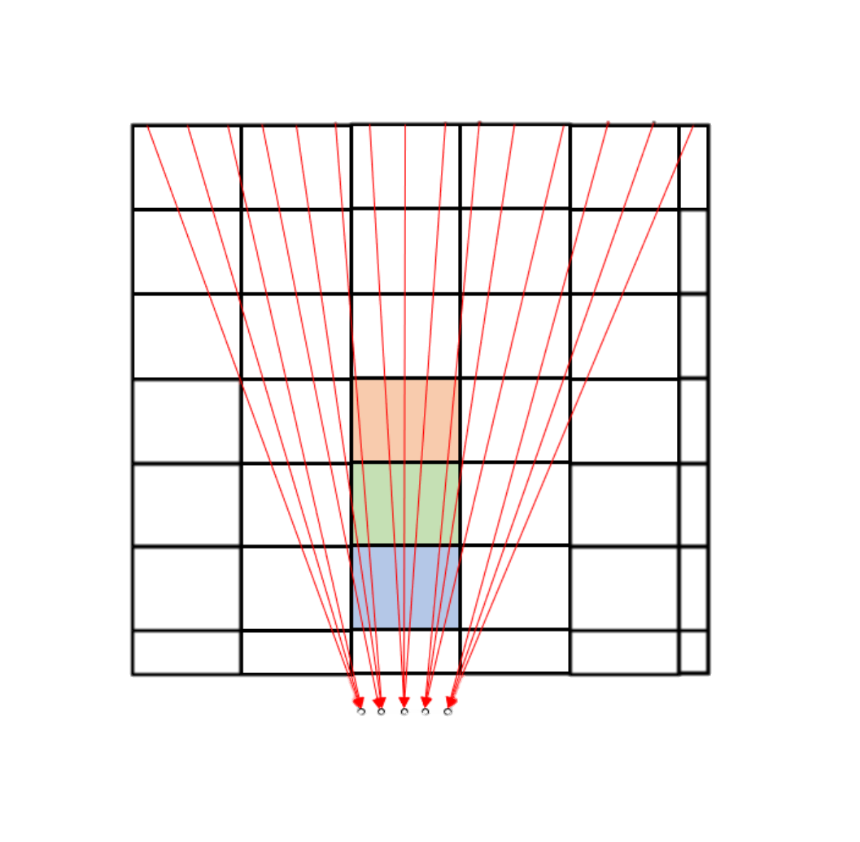
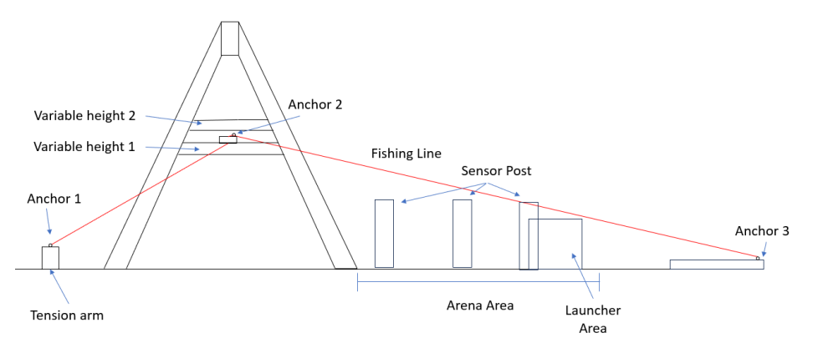
Game Board
Game Board Layout
Two different Variable Heights
15 Different lines where the Golf Ball can Slide
Pink Box is the Solution

Slide 4
Rules and Constrains:
The interceptor must not present a danger to the judges or the audience.
The interceptor must not contain or use any explosives, pyrotechnic, toxic, flammable or corrosive materials.
The interceptor must fit within a 1x1x1-foot restriction before the power switch is flipped.
The interceptor is allowed to extend past the 1x1x1 foot restriction once the power switch has been flipped on.
The interceptor must have a clearly marked power switch and an emergency stop.
The interceptor is allowed to use wall outlet power
The sensors attached to the sensor post are not included inside the 1x1x1 cubic foot box.
The sensors on the sensor post must communicate wirelessly to the launcher and must have independent power from the launcher
Interceptors must work on their own. Any outside interference or assistance will cause immediate disqualification.
one person from each team will be allowed to touch the robot from the staging area to the competition board and to operate the pause switch/button.
The person, also known as the robot handler, will then be allowed to pause the robot and turn it off and on.
Pausing will only be allowed three seconds after projectile is committed upon
Scoring will cease as soon as the person turns off the interceptor.
The pause button cannot assist in shooting the projectile in any way other than taking the mechanism to a pause state

Slide 5
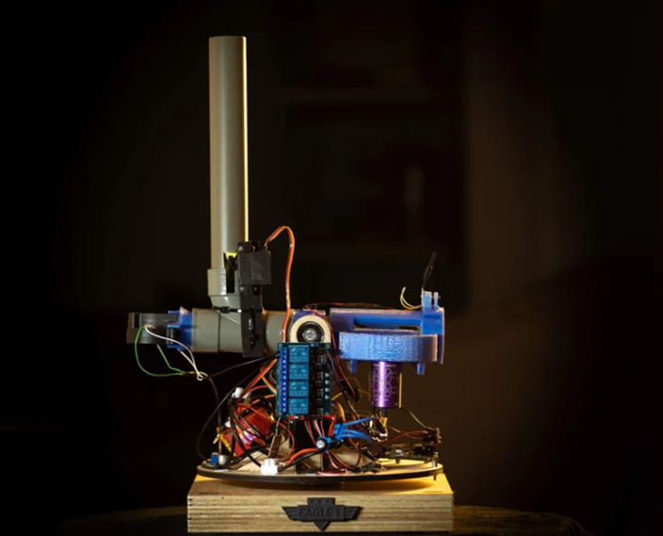
Idea Generation
Using an instructables model as shown on the right we were able to start getting ideas for how to design our launcher
Broke down our launcher into four separate problems
Magazine Design
Launching Mechanism
Movement System
ECE Team Integration
https://www.instructables.com/Arduino-NERF-Ball-Wireless-FPV-Sentry-Turret/.

Slide 6
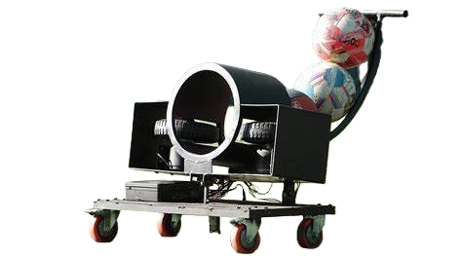
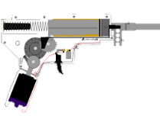
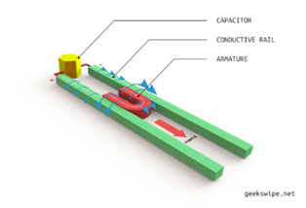
Launcher Ideas
Winner
PROS
Prefab models available
Cheap
Greater Launching Speed
CONS
Bulky
PROS
Prefab Models Available
Cheap
CONS
Harder to Adjust Power
PROS
Innovative Concept
Less Moving Parts
CONS
Expensive
No Prefab Units
Options for Launching Mechanism
Fly Wheel Mechanism (Left)
Spring Launcher (Middle)
Electro Magnetic Coil Launcher (Right)

Slide 7
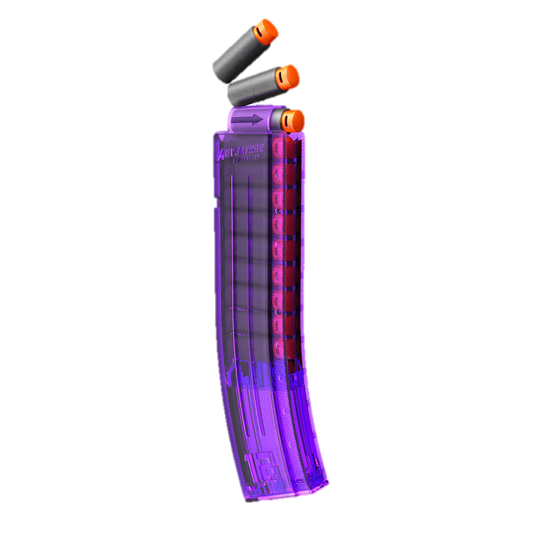
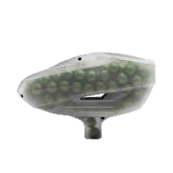
Magazine Ideas
Winner
PROS
Comes With Many of the Prefab Launchers
CONS
Limits Projectiles that Can be Used
Uses More Space
PROS
Less Moving Parts
CONS
Limits Projectiles that Can be Used
Might Jam
Options for Magazine
Spring Magazine (Left)
Gravity Fed Magazine (Right)

Slide 8
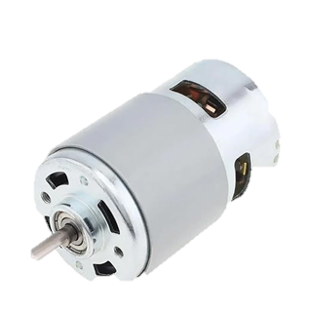
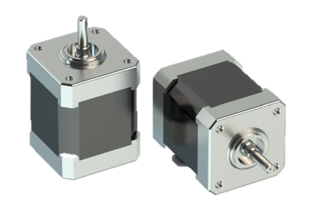
Movement System Ideas
Winner
PROS
Faster Spinning
CONS
Low Torque
Low Movement Accuracy
PROS
Slower Spinning
Higher Movement Accuracy
CONS
Higher Torque
Options for Moving System
DC Motors (Left)
Stepper Motors (Right)

Slide 9
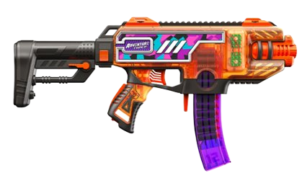
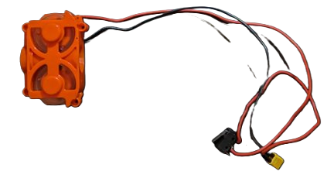
Building The Launcher
It was decided that a spinning flywheel launcher would be the easiest and most time conservative option
The Adventure Force Tactical Strike that is sold in most Walmart's was used for most of the launcher's parts as it required the least amount of modification.

Slide 10
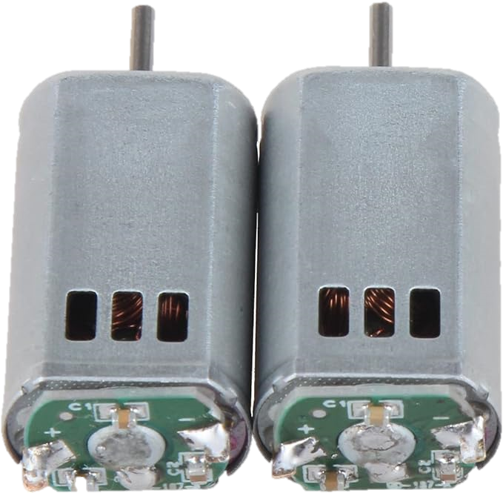
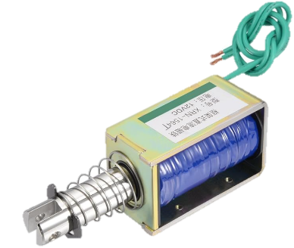
Launcher Electronics
Solenoid was used as it is the easiest device that can push a projectile into the spinning wheels of our launcher.
Two DC motors provided the spin our launcher needed to launch the projectiles.

Slide 11
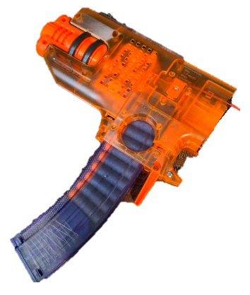

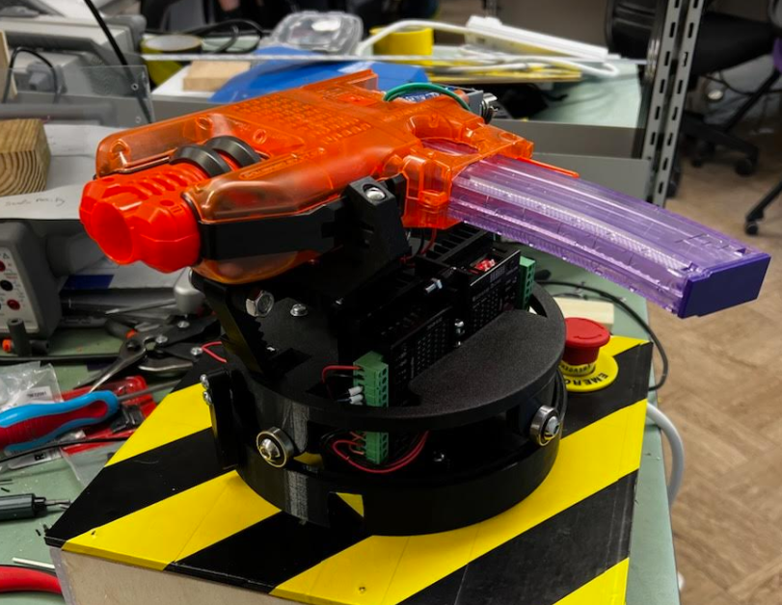
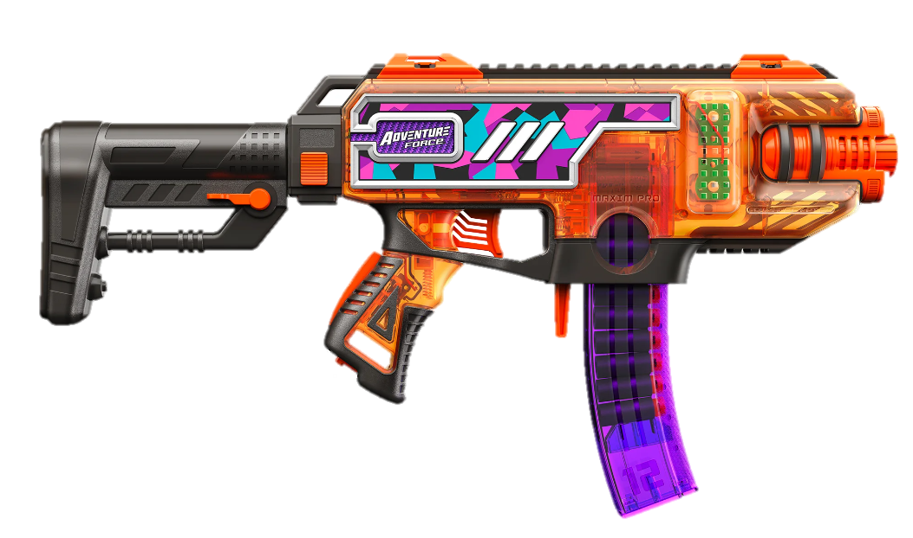
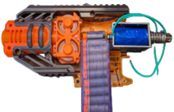
Modifying The Launcher

Slide 12
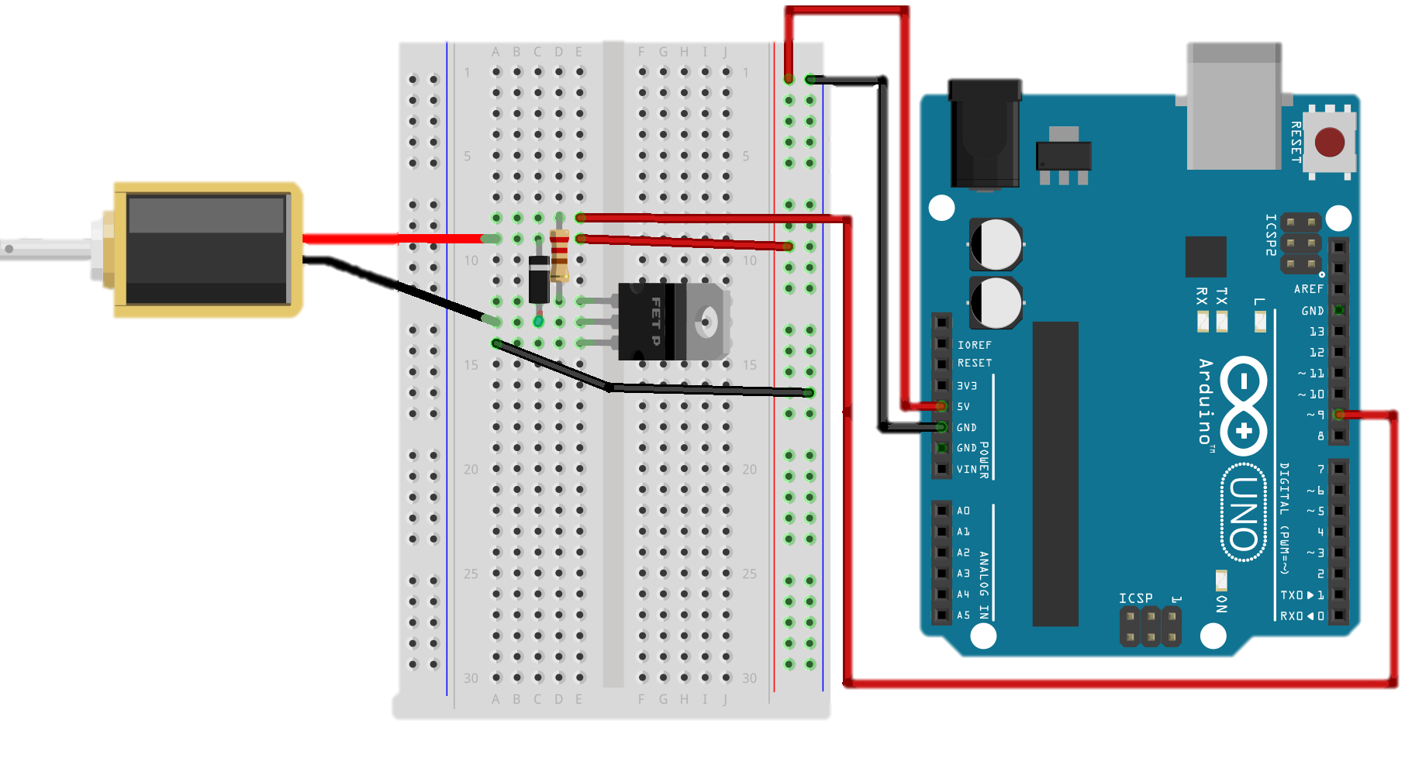
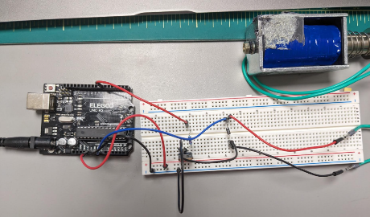
Wiring the Top End
The main concern for the launcher was supplying power to the solenoid. It required much more power than the other systems. To get around this a transistor was used to make sure the extreme power wouldn’t reach the Arduino and fry it. Along side the diode that would also allow the power to only travel in one direction.

Slide 13
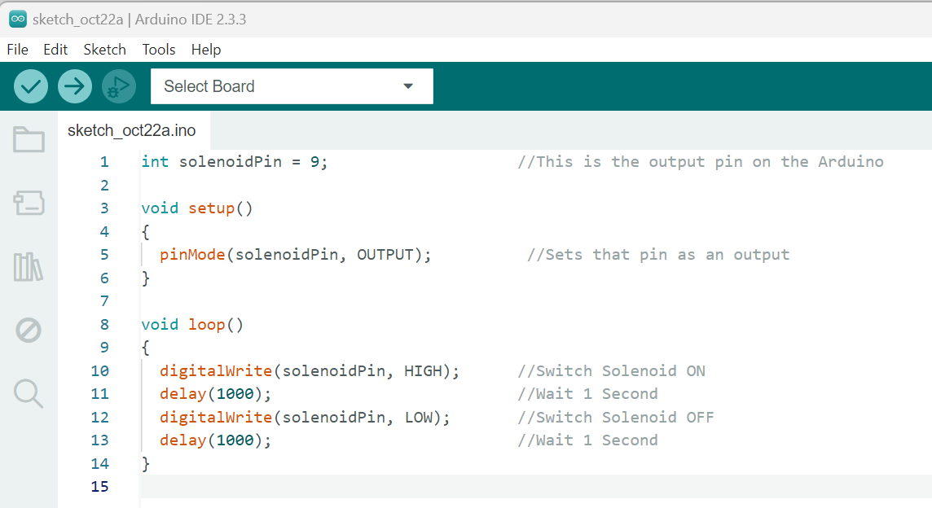
Coding the Top End
The following code was used to run the solenoid once a specific input was given from the Intel RealSense camera.

Slide 14
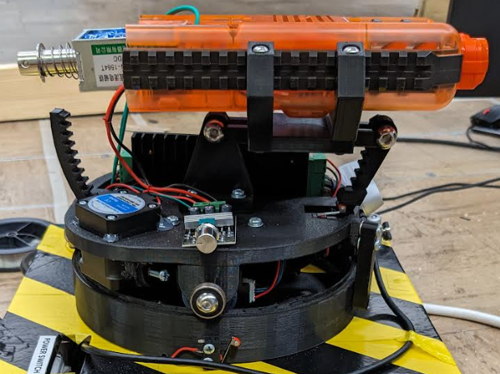
Controlling Launcher Motor
The speed of the flywheels is controlled by the speed controller shown to limit the amount of code that was needed and give fine control over the projectiles path.

Slide 15
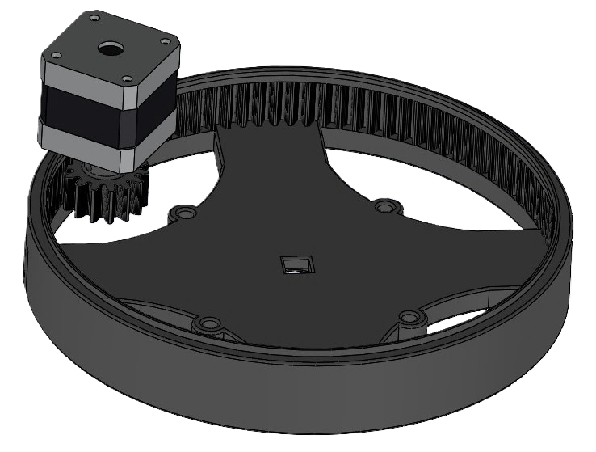
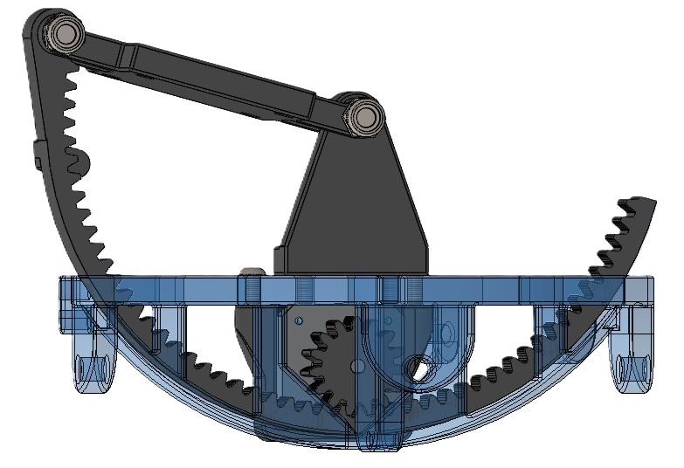
Movement System
This motor controls the launchers direction by turning the smaller gear
This motor controls the launchers elevation by turning the outer gear to the left or right

Slide 16
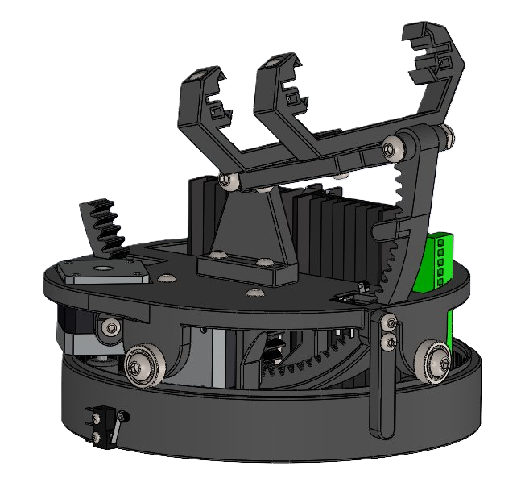
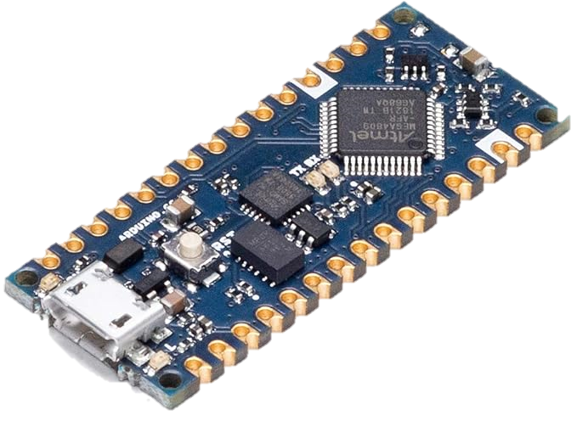
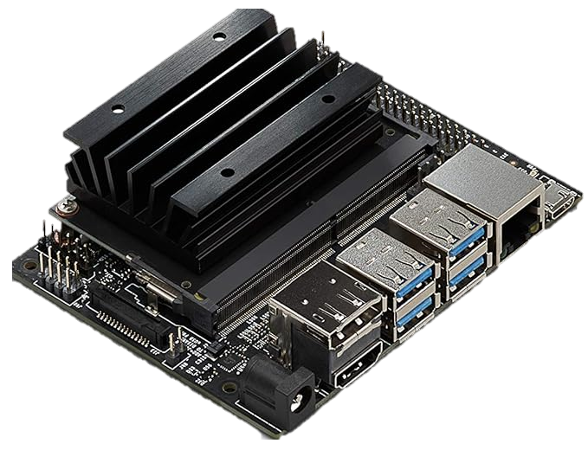
Movement System
The movement system is powered by two Nema 17 stepper motors controlled by two TB6600 motor drivers
These drives are controlled by an Arduino Every that receives signals from the jetson nanos image processing.
The Stepper motors did not include encoders so we could save on money

Slide 17
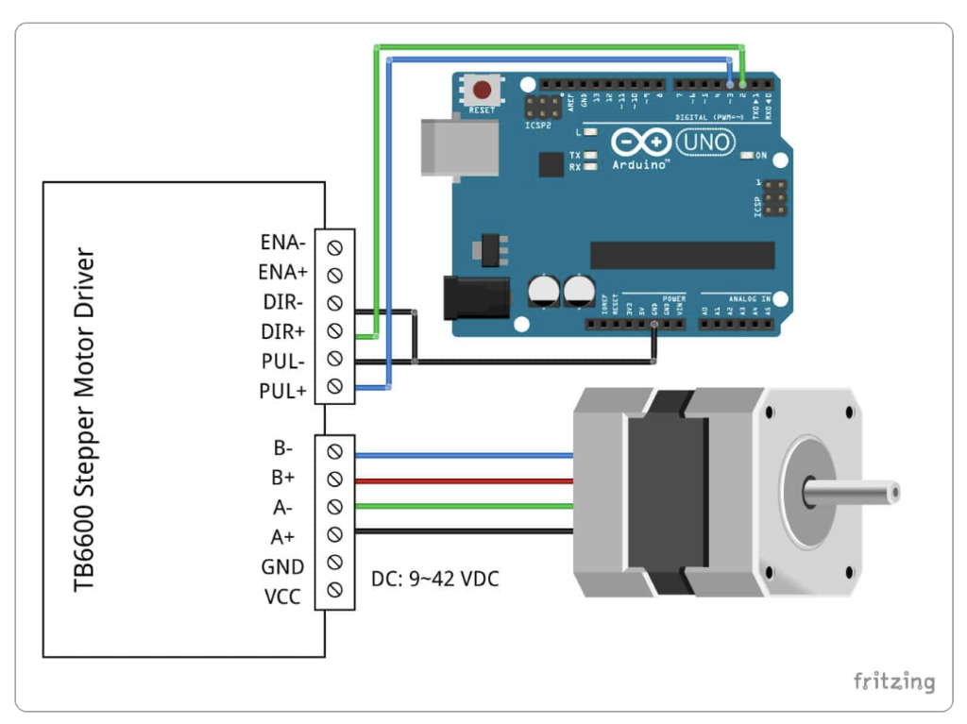
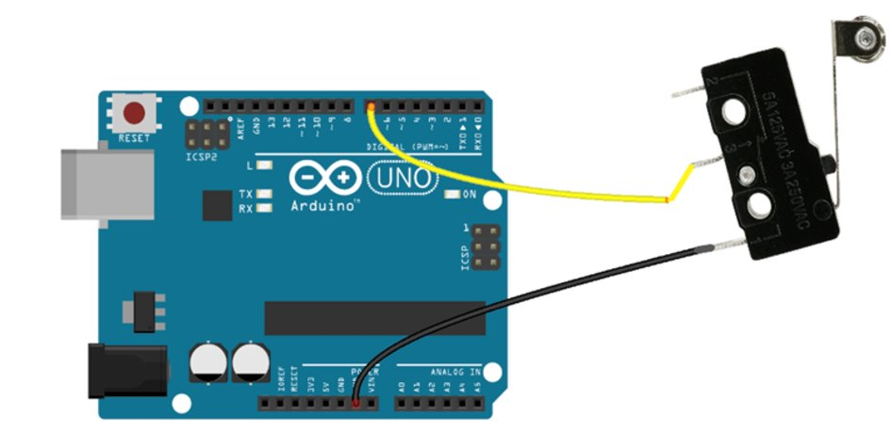
Wiring The Movement System

Slide 18
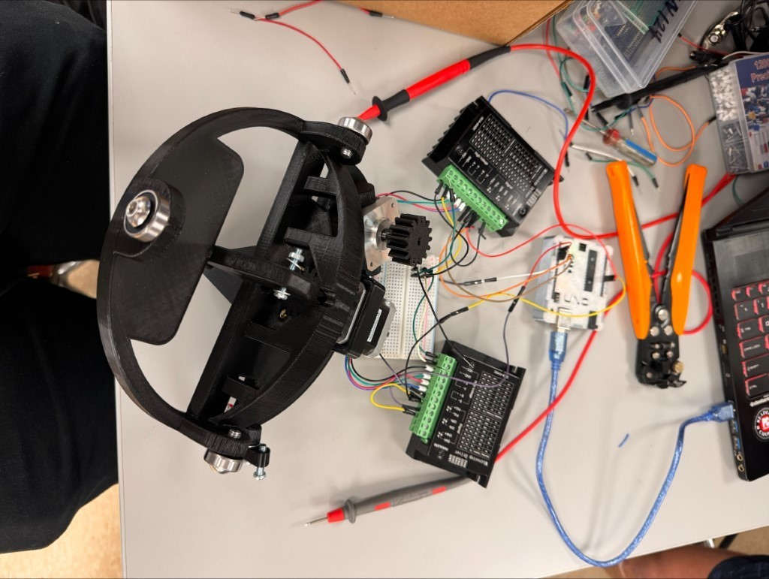
Wiring The Movement System

Slide 19
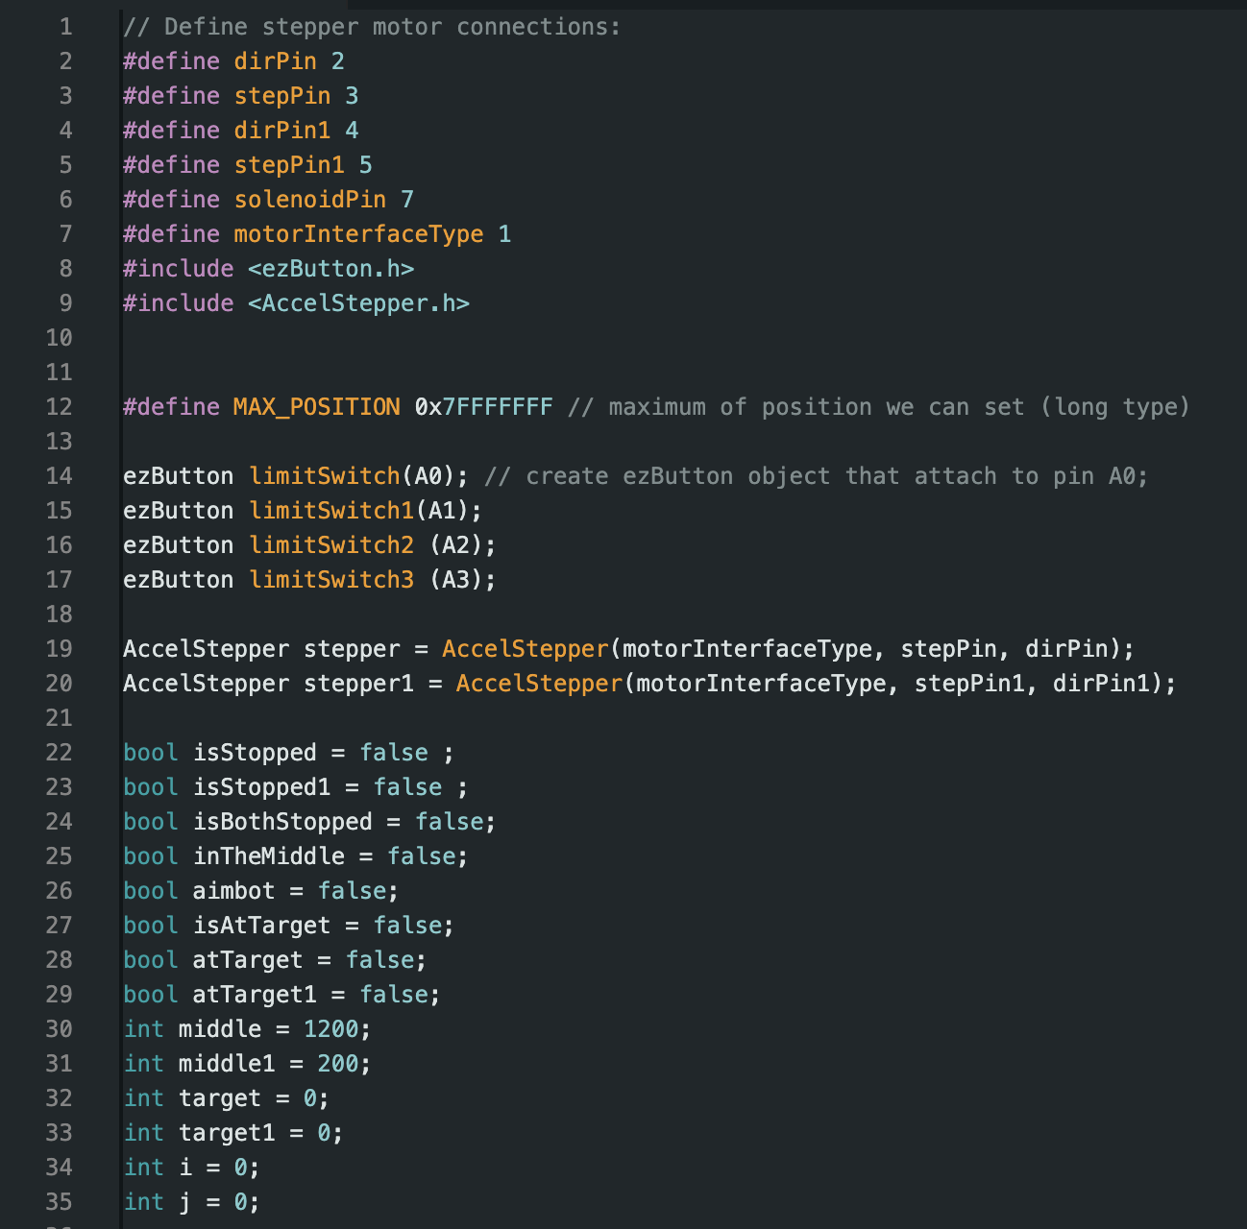
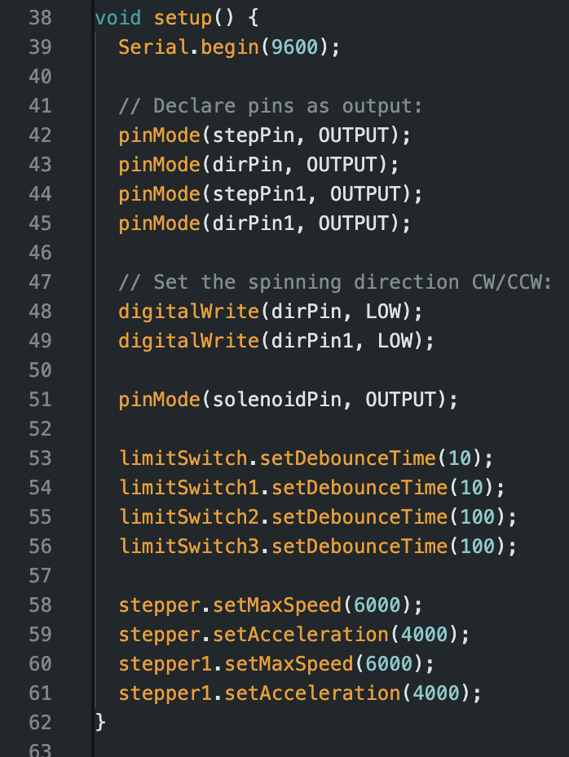
Coding The Movement System
Code Initialization

Slide 20
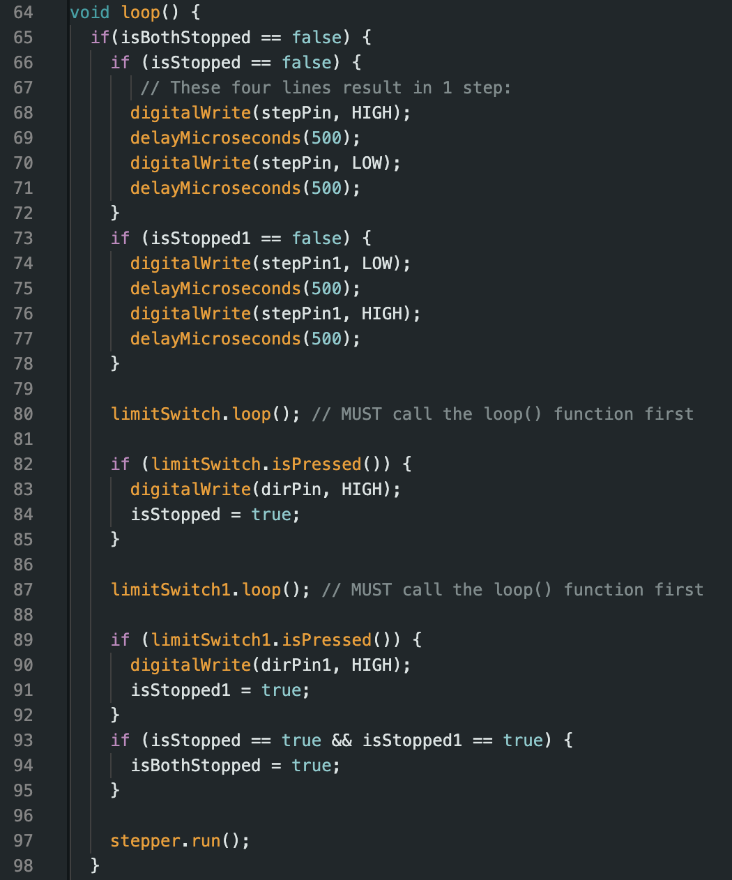
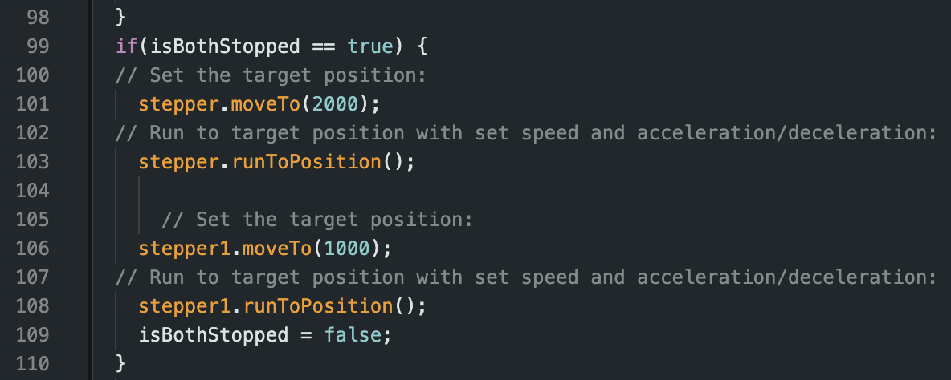
Coding The Movement System
Setting the zero point
Move to middle

Slide 21
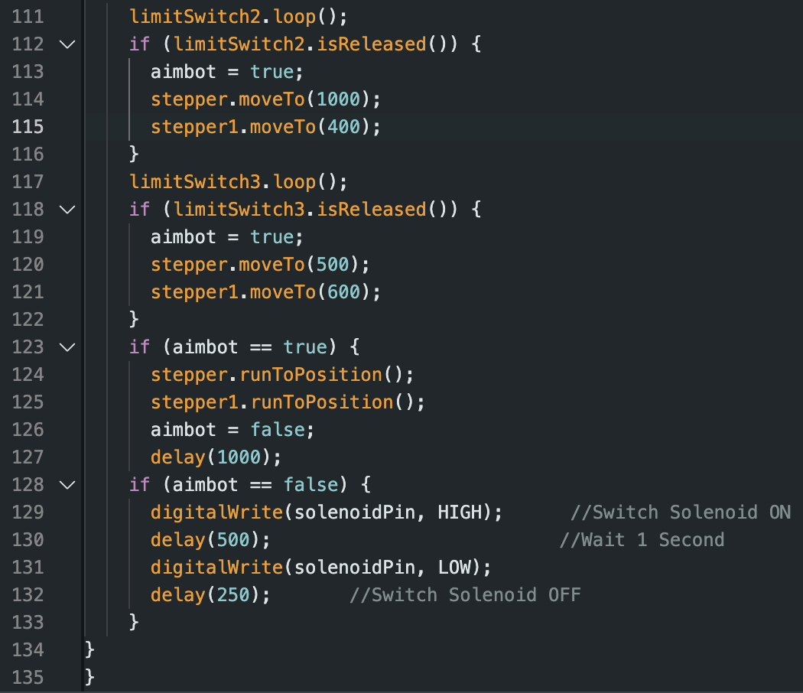
Coding The Movement System
Aim & Fire

Slide 22
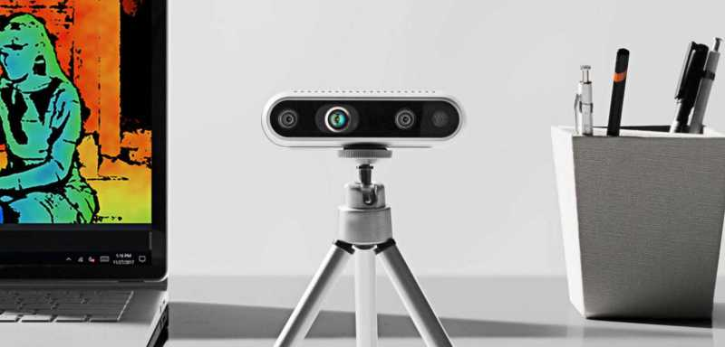
ECE Integration
An Intel RealSense Camera was used to provide the depth and range data which was sent to the jetson nano to translate the coordinates that the launcher would need to hit the moving target.

Slide 23
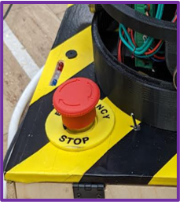
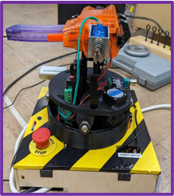
Miscellaneous Features
Hit or Miss Lights and Buzzer
Emergency Stop and pause switch

Slide 24
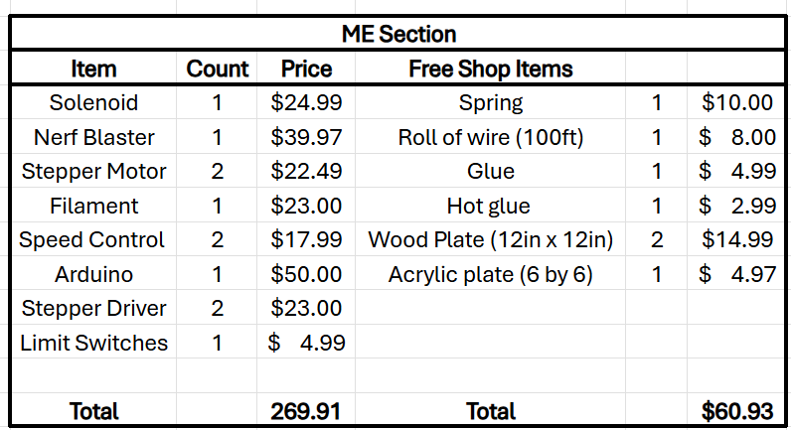
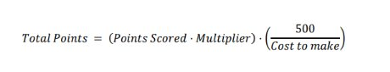
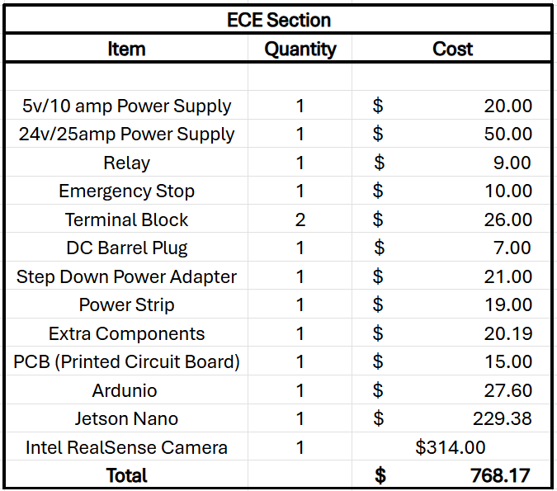
Budget and Improvements
Costs Were Higher Than Expected
Certain Items Could Have Been Found at Reduced Prices
Lower Quality Items Could have been Used
Less Heavy-Duty Versions Were Available

Slide 25
Acknowledgments
We would like to thank Tennessee Tech for the funding and opportunity that was provided for this project. We would also like to thank the ECE team that helped in collaborating with us to fabricate and optimize the launcher system. Those being Garret Armstrong, Kevin Ulrich, Jonathan Neal, Katherine Swinea, Finlay Patoto, and Savannah Metzler. Finally, we would also like to thank the members of Devcom who gave us this opportunity to show the culmination of our engineering education and Dr. Pardue for his mentorship.

Slide 26
Questions?

